Slide 1
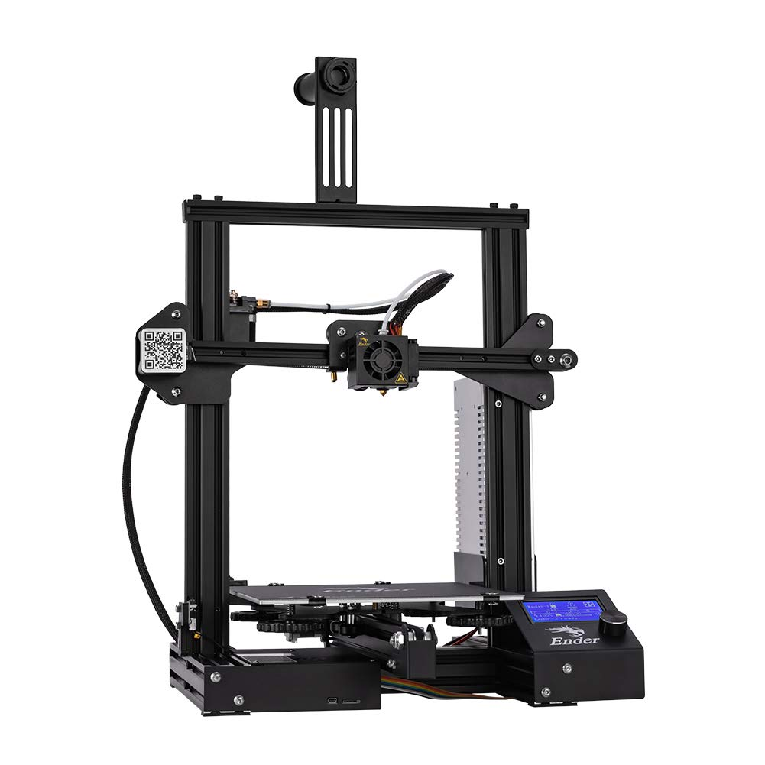

Final Presentation Team 21: 3D Printer and Application Cody Hutchison Steven Liu Abigail Morar TA: Milenka Gamero Sponsor: Dalton Cyr

Slide 2
Problem Overview
Current 3D printers require the user to manually upload a G-code file by an external storage device and initiate the printing process via controls on the printer
The new 3D printer and Application will allow the uploading, controlling, and initiation of printing from anywhere with internet access. The print time will also be within 10% of the Ender 3 printing time.

Slide 3
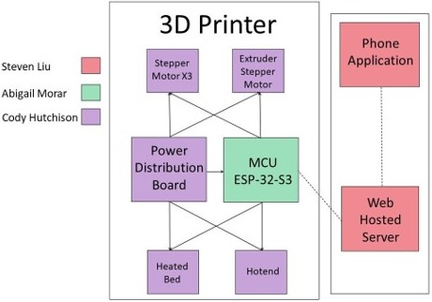
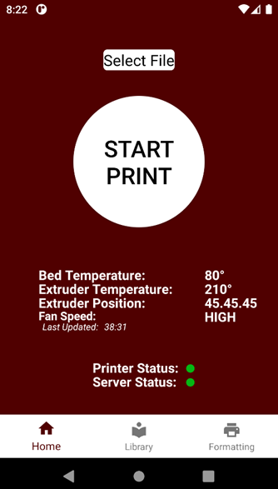
Integrated Project Diagram

Slide 4
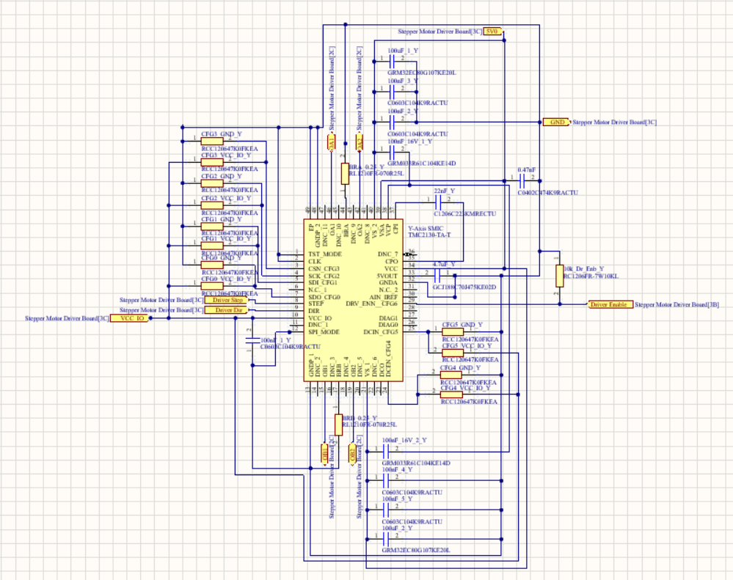
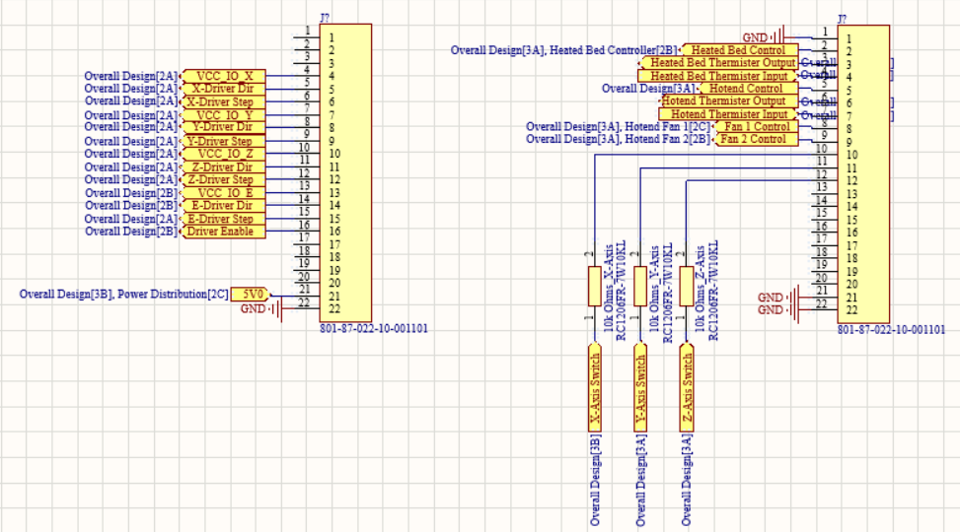
Electrical Subsystem
Overview
The electrical subsystem was the heart of the 3D printer providing power to the MCU, stepper motors, thermistors, fans, hot end, heated bed, and switches.
The printed circuit boards also routed control signals between the MCU and the stepper motors, thermistors, and switches.
The Main Control board also converted 24Vs down to 5V for the stepper motors and MCU.

Slide 5
Electrical Subsystem Controller PCB
Challenges
Clean power to the MCU and Stepper Motors
Headers for MCU were the right size and correct distance apart
First time using Altium and designing a board
Solutions
Ensured the efficiency of the power converter was within limits
Multiple measurements with calipers to verify width and pin spacing
Watched many tutorial videos and reaching out to others for assistance when needed

Slide 6
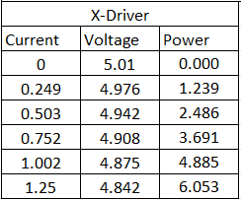
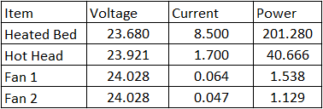
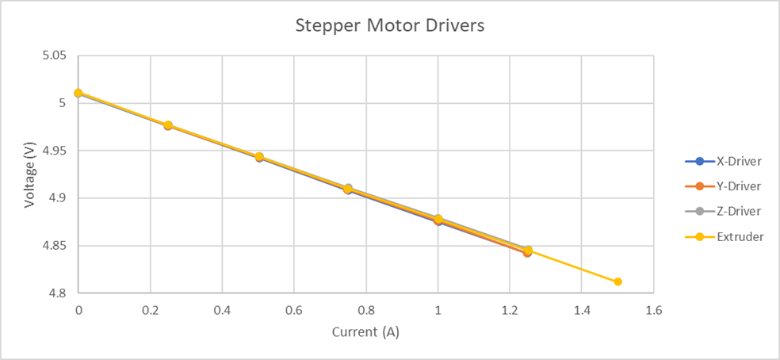
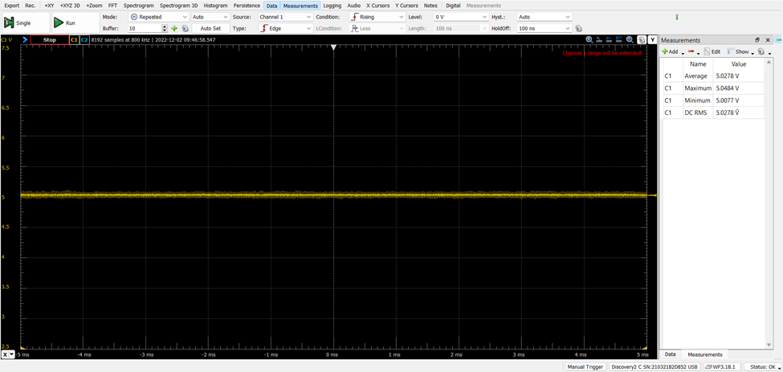
Electrical Subsystem Controller PCB Results
Power supply and conversion Testing
The power supplied to the 3D printer and converted to 5V needed to be within 2% of 5V. We tested the Stepper Motor drivers from 0V to 1.25V which is 25% over the max current of the stepper motor voltage. The results showed that the voltage was pretty well within the threshold and didn’t fluctuate either. The heated bed, hotend and fans were tested as well and the voltage stayed within the required threshold as well and the systems worked as expected.

Slide 7
Electrical Subsystem Stepper Motor Driver PCB
Challenges
Understanding how stepper motors operated
Learning how the TMC-2130 chip set operated and which operation was best for our application
Understanding the schematics in the datasheet
Solutions
Hours spent on Youtube and Google watching videos and reading articles on stepper motors
Reading through the datasheet and researching the different methods such as SPI
Researching different terminology and asking others for clarification

Slide 8
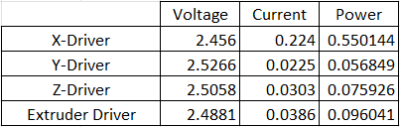
Electrical Subsystem Stepper Motor Driver PCB Results
The axis drivers were expected to be taking 5V of power and using around 1A but from our testing they used half the voltage and about ⅓ the amperage and are running smoothly as seen in the video below.

Slide 9
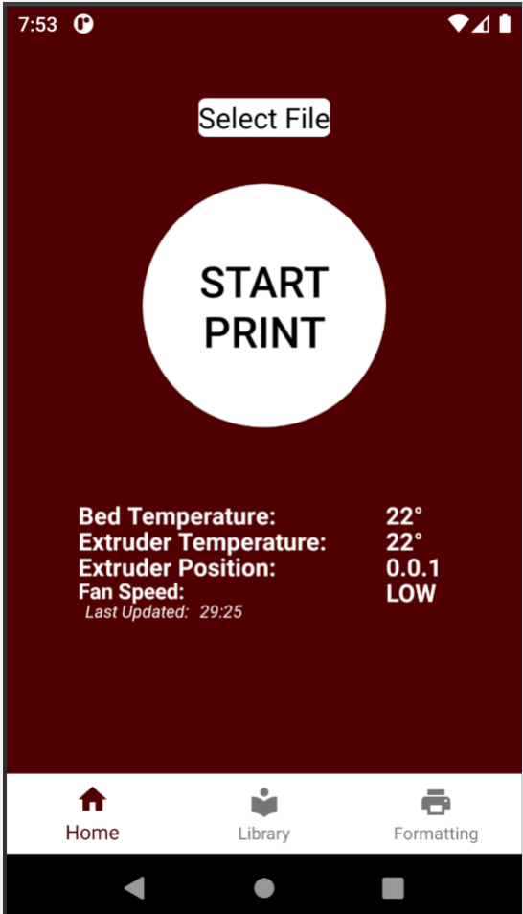
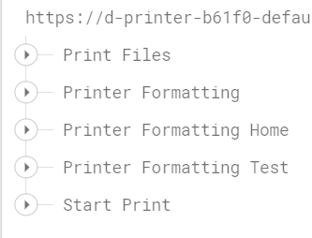
Application and Server Subsystem Overview
Steven Liu
The Application is the user interface for handling all user inputs and communication to the 3D printer.
The server provides a database and storage for organizing print files and handling information to be communicated to the 3D printer.
Together the Application and Server are important for allowing users to communicate remotely to the 3D printer.

Slide 10
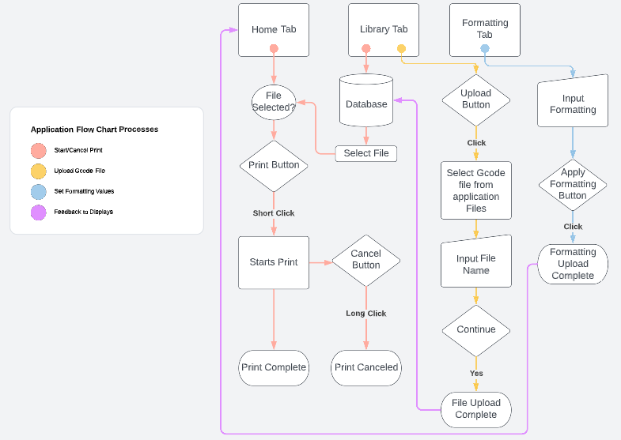
Application Flow Chart
Steven Liu

Slide 11
Application and Server Subsystem
Steven Liu
Challenges
Learning new programming language and coding in Android Studio
Integrating Firebase and handling communication
Communicating between different fragments within the app
Designing an interactive library
Solutions
Research done through Youtube videos, Android documentation, and Firebase documentation
Consulting previous and relevant information in Q&A programmer sites such as Stack Overflow
Debugging and improving designs

Slide 12
Application and Server Subsystem Results
The application and server have been able to perform all required functions along with a few additional in-app functions.
Tasks | Efficiency
Start/Cancel Print to database | 100%
Upload new file to database | 98%
Update Formatting values to database | 100%
Display Library Files | 100%
Display 3D Printer parameters in App | 100%
Communicate between tabs | 100%

Slide 13
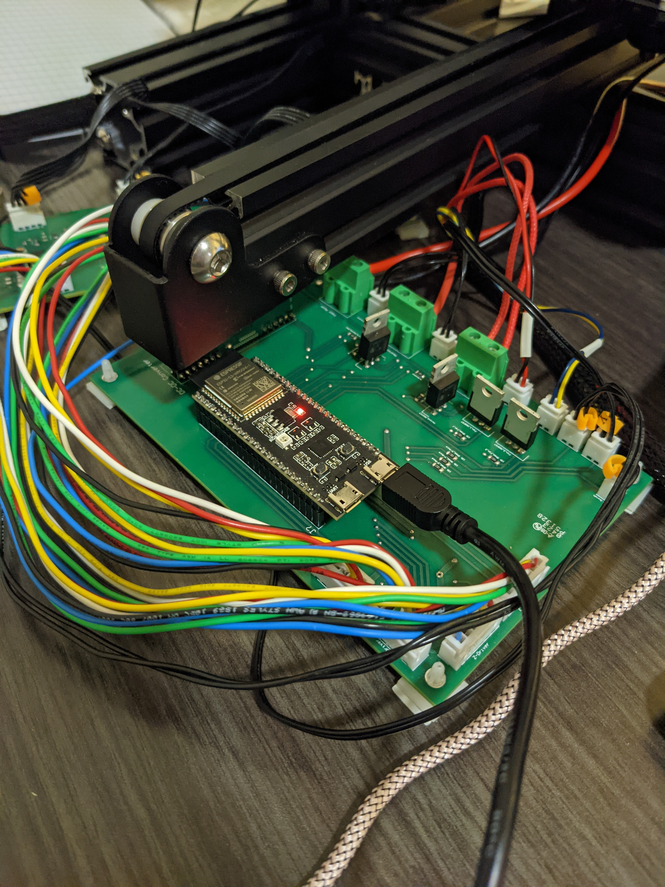
Microcontroller Subsystem Overview
Abigail Morar
The microcontroller is the brain of the 3D printer, connecting and controlling all parts of the system together.
The microcontroller performs all the calculations and readings to and from the electrical components and application and server.
The microcontroller allows the user to 3D print whatever is designed.

Slide 14
Microcontroller Subsystem
Abigail Morar
Challenges
Learning the programming language, IDE, and g-code commands
Implementing the code and constant debugging
Understanding how the microcontroller reads in values and outputs information
Solutions
Constant research using youtube videos and articles and previous user programs for examples and understanding
Seeking guidance from peers and professionals
Reviewing header files from the manufacturer

Slide 15
Integrated System Results
The MCU is capable of sending commands that can control the hotend and heated bed via thermistor readings. Run and operate all 4 of our stepper motors making 1mm steps. Can turn on and off both hotend fans.
Connects fully to the application/server by reading from appropriate nodes and updating components accordingly. Also reports new/current temperature values, extruder location, and fan and print status back to the server.
MCU reads in g-code from the correct path in the database and parses the incoming information.

Slide 16
Integrated System Results

Slide 17
Conclusions
Issues were discovered with the design of the thermistors and switches that have been corrected via wire jumpers on the current Main Control Board
For the stepper motor end switches, there is an issue with the ADC input floating due to circuit design
Currently the MCU does not read complete g-code file, there is an issue with the pull request unable to handle the file size
Minor updates needed to perfect the printer accuracy

